Slide 1
Data Ingestion In Pictures!
Images taken in QGIS: https://www.qgis.org

Slide 2
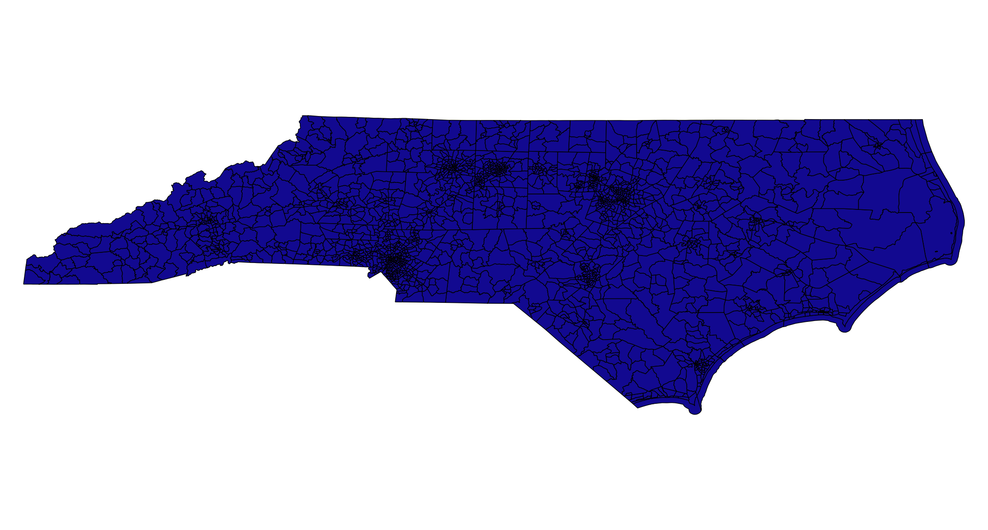
Get the North Carolina state shapefile from U.S. Census
Images taken in QGIS: https://www.qgis.org

Slide 3

Isolate the county we’re interested in (Mecklenburg County, NC)
Images taken in QGIS: https://www.qgis.org

Slide 4
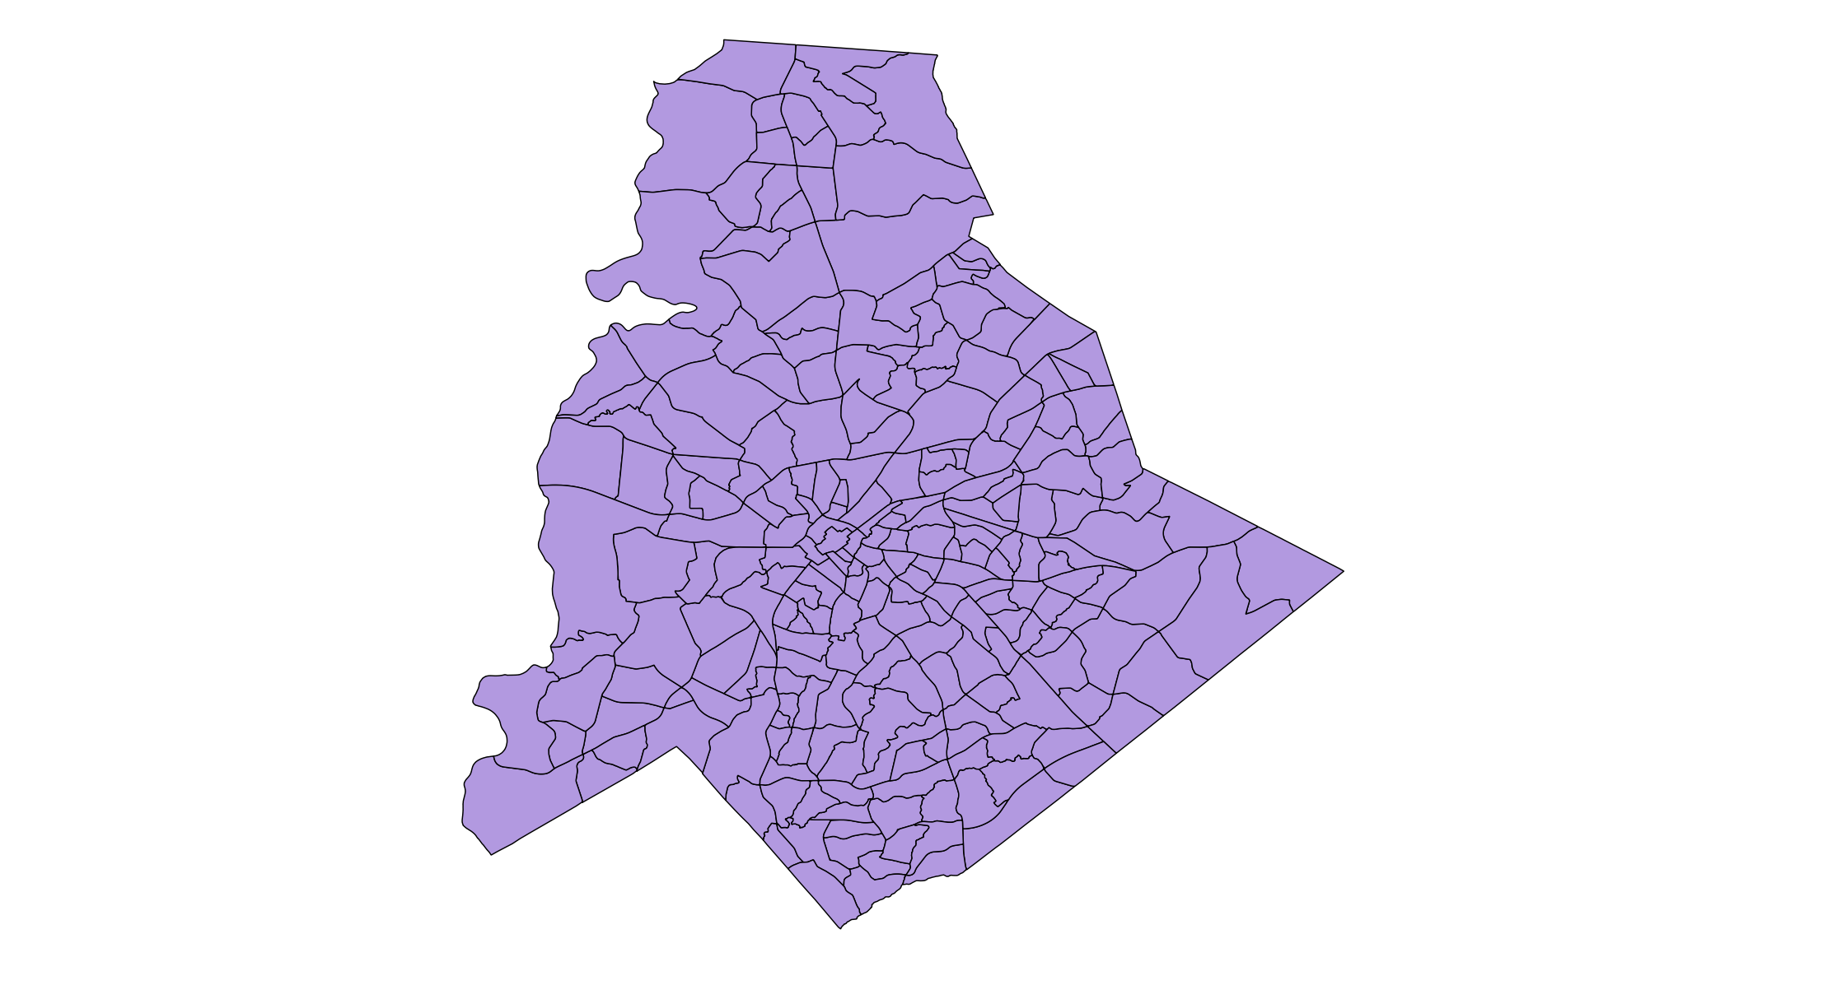
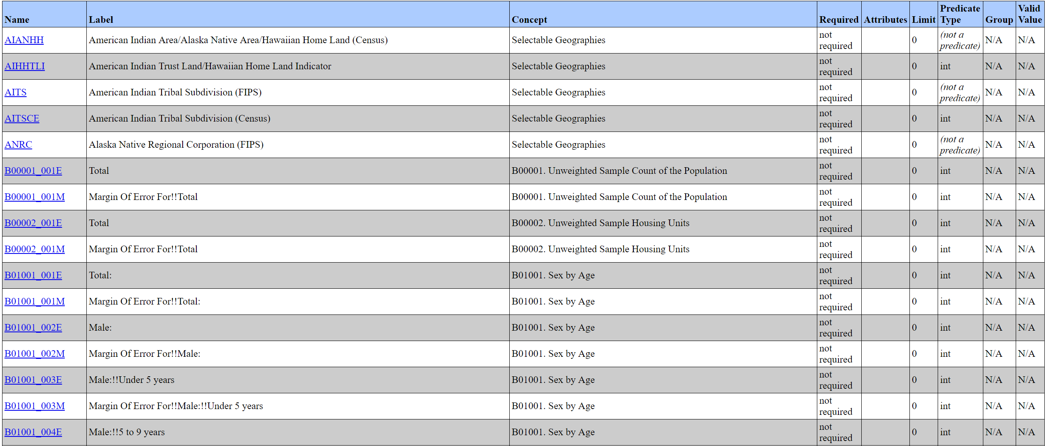
Get demographics for each tract from the U.S. Census API (ACS 5)
Images taken in QGIS: https://www.qgis.org

Slide 5
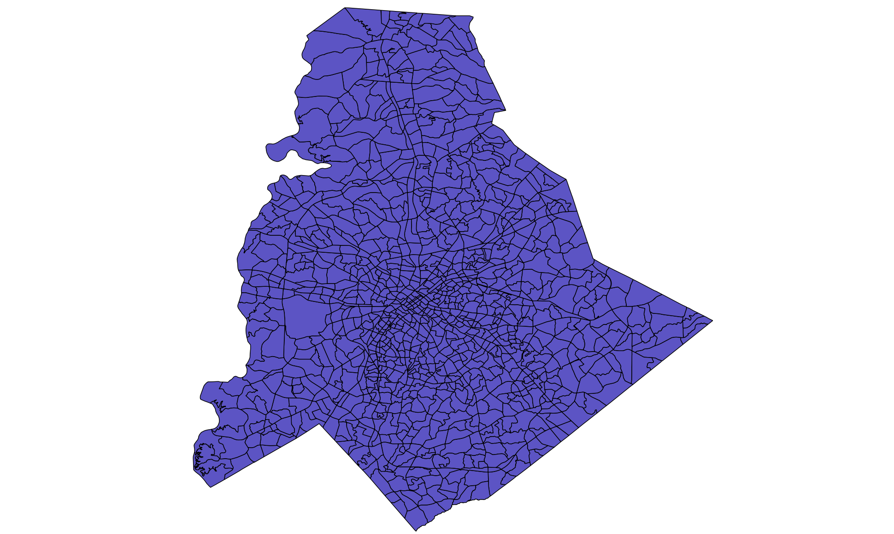
Incorporate finer-resolution data from Mecklenburg County and reaggregate tract-level data
Images taken in QGIS: https://www.qgis.org

Slide 6
Get more data!!
Zoning Data
Road Data
Traffic Analysis Zone Data
Images taken in QGIS: https://www.qgis.org

Slide 7




Extract features
Area (sq. mi)
15
20
18
Population Density (people / sq. mile)
466.67
1,500
4,444.44
Feature extraction reduces model complexity
Population
7,000
30,000
80,000
$$÷$$
$$=$$
Single-Family Residence
0.25
0.33
0.02
Multi-Family Residence
0.1
0.5
0.2
Residence
0.35
0.83
0.22
$$+$$
$$=$$
Represents proportion of area that is zoned for single-family residences
Images taken in QGIS: https://www.qgis.org

Slide 8
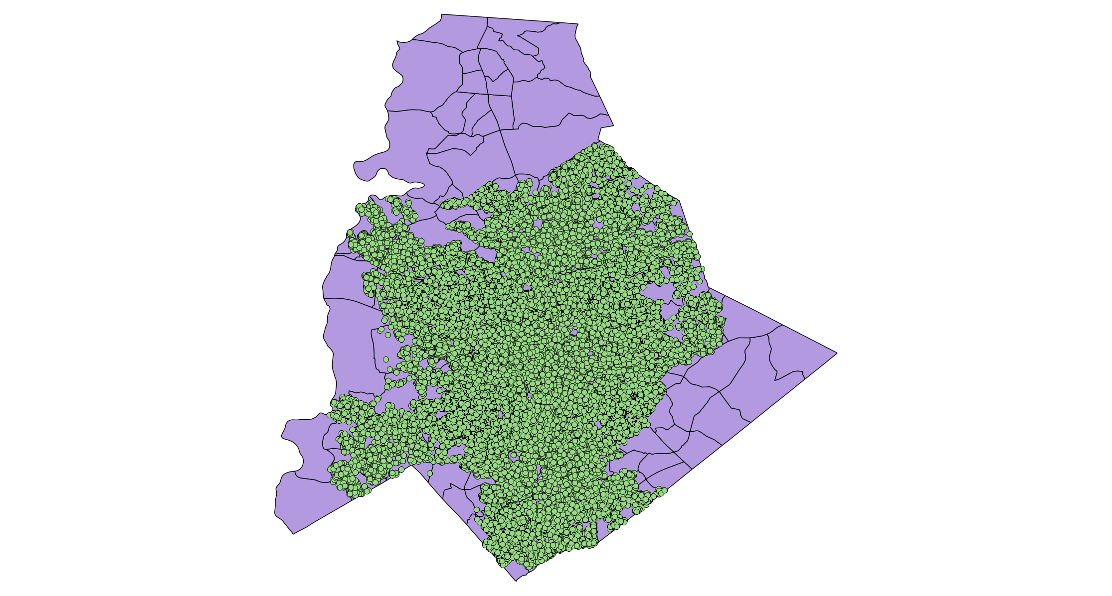
Use 9-1-1 emergency records to identify where emergencies occurred throughout the year
Each SHAPE contains data about the region.
Each POINT contains data about the emergency (what, where, when… NOT WHO!)
Images taken in QGIS: https://www.qgis.org

Slide 9
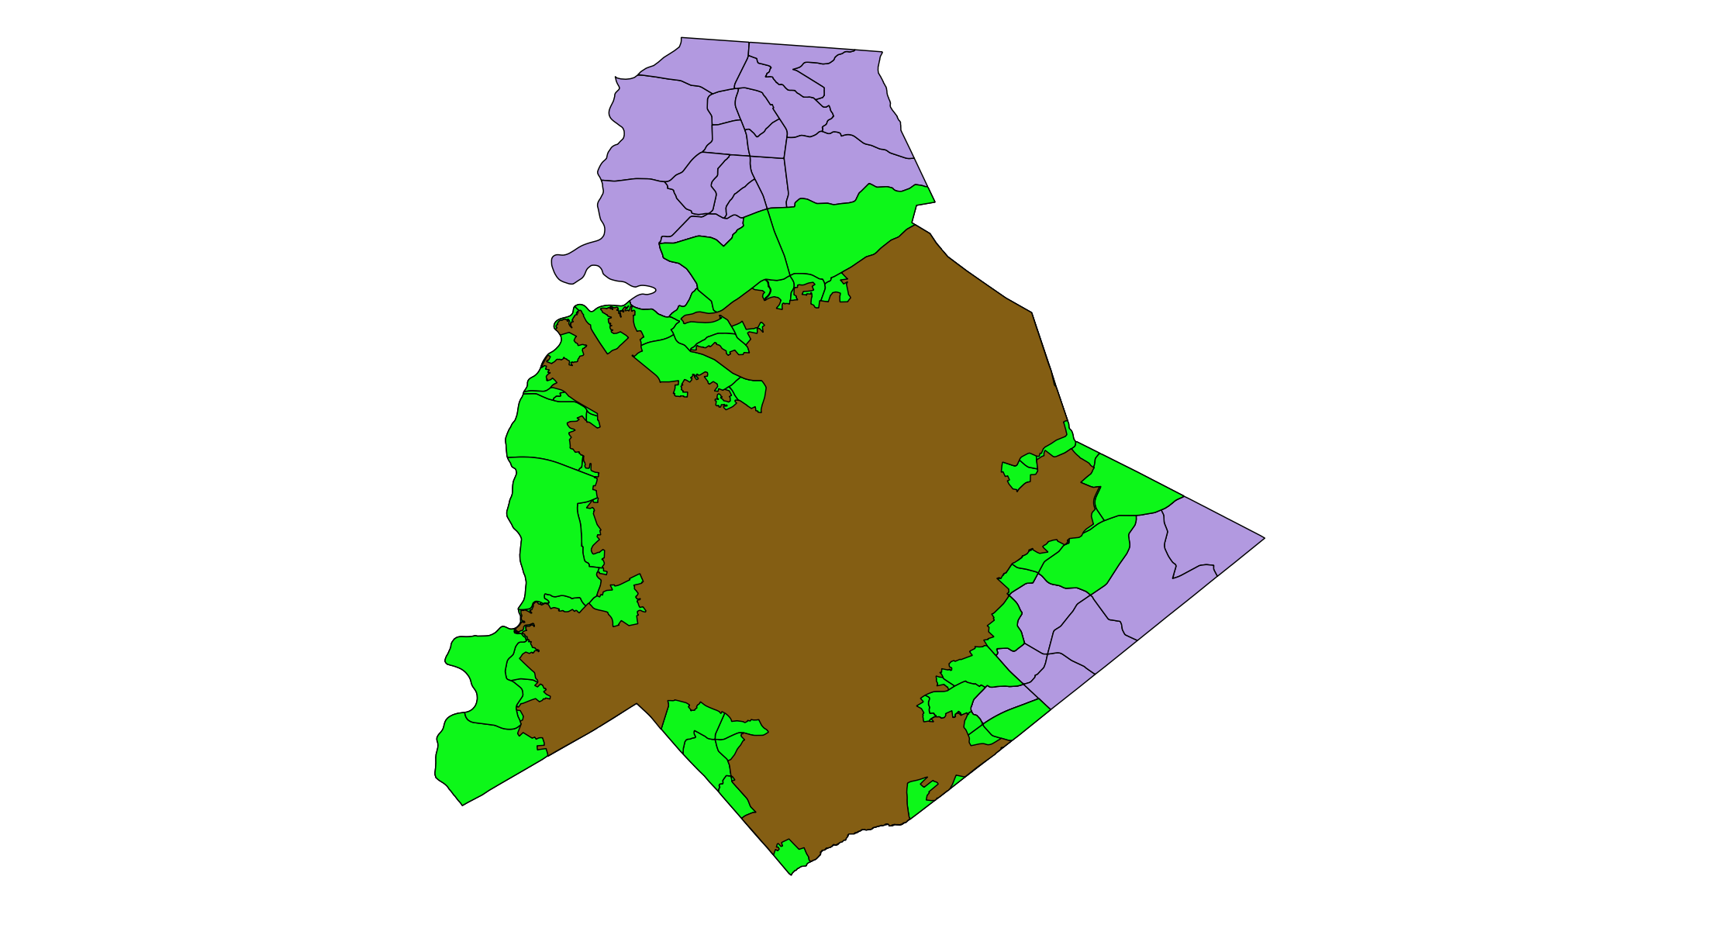
Isolate the City of Charlotte’s response area
Isolating shapes in Charlotte’s response area
Images taken in QGIS: https://www.qgis.org

Slide 10
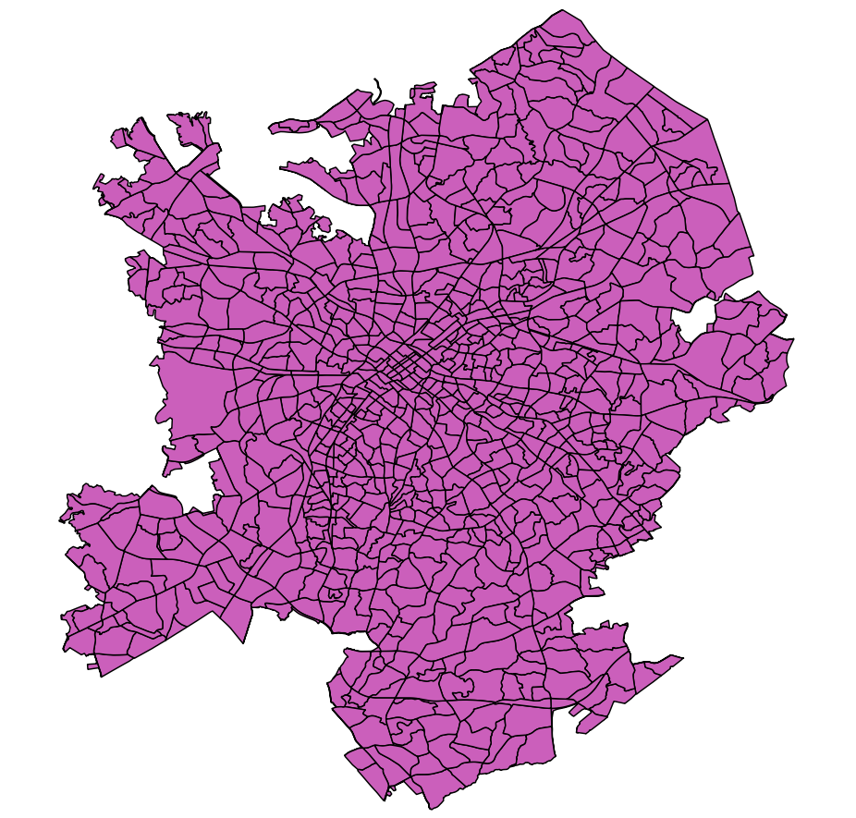
Use areal interpolation to reaggregate data into new shape boundaries
Example: if only half of this shape is left, we only consider half the original shape’s population in our analyses
Images taken in QGIS: https://www.qgis.org

Slide 11
Analysis In Pictures!
Images taken in QGIS: https://www.qgis.org

Slide 12
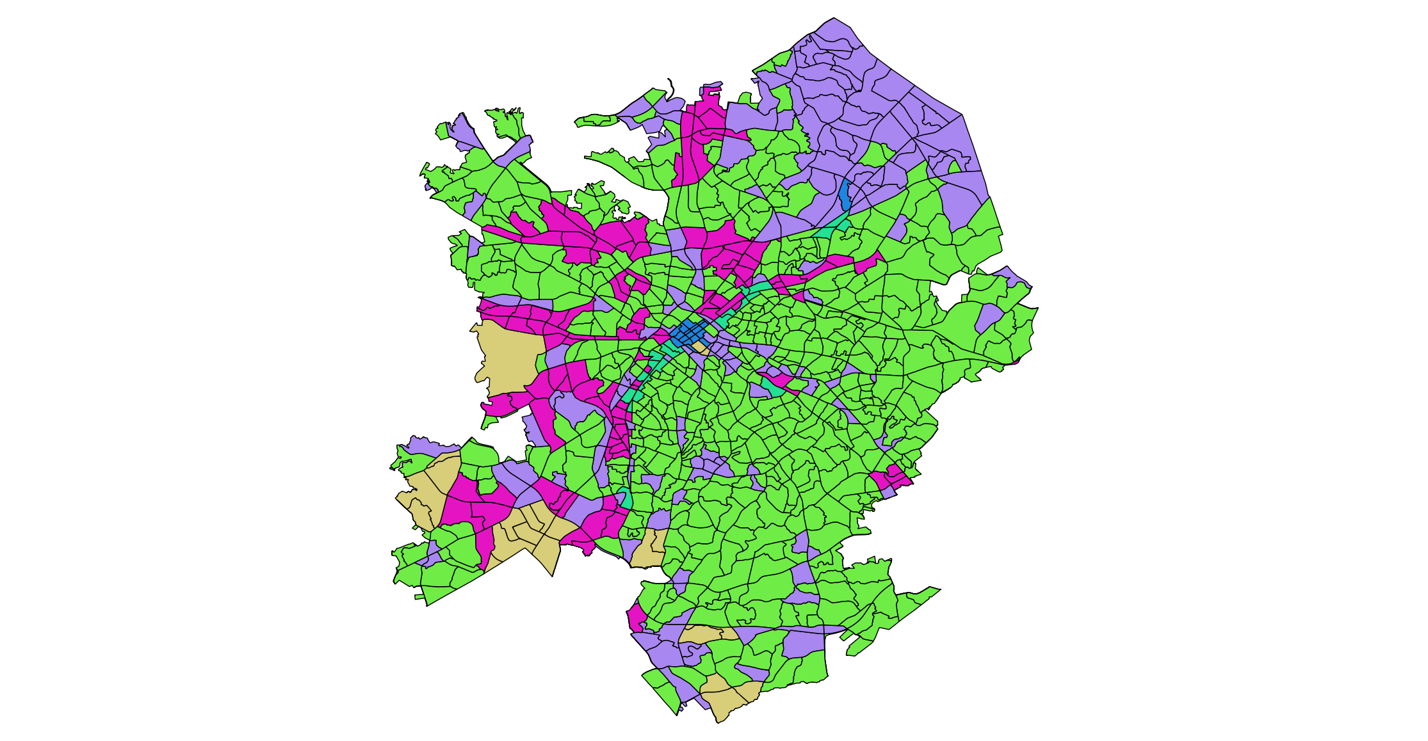
K-means clustering
Each color represents areas that are found to be most similar when considering all their attributes
Images taken in QGIS: https://www.qgis.org

